Slide 1







Technology Usage
Brionna Purifoy-Brooks
February 29,2024

Slide 2



OUTLINE
Executive Summary
Introduction
Methodology
Results
Visualization – Charts
Dashboard
Discussion
Findings & Implications
Conclusion
Appendix

Slide 3

EXECUTIVE SUMMARY
Data Context and analysis goal.
Methodology
Data Gathering
Data Analysis
Data Visualization
Visualizations results using graphs and showing trends
Discussion and implications of findings
Final conclusions of research

Slide 4

INTRODUCTION
Stack Overflow's annual Developer survey is one of the largest and most comprehensive survey of people who use coding software around the world.
Results don’t represent everyone in the coding community.
Nearly 90,000 coders participated in the survey.
Surveys found trends for Database, Platform, and Program Language
Trends for the ones are being used now
Trends for the ones that are being prospected

Slide 5

METHODOLOGY
Collect survey data & explore its content
Web scraping
Requesting Libraries
Data Wrangling
Exploratory data analysis
Analyzing data distribution.
Handling outliers.
Correlations.
• Data Visualization
• Highlight distribution of data, relationships, the composition and comparison of data
Dashboards

Slide 6
RESULTS

Slide 7
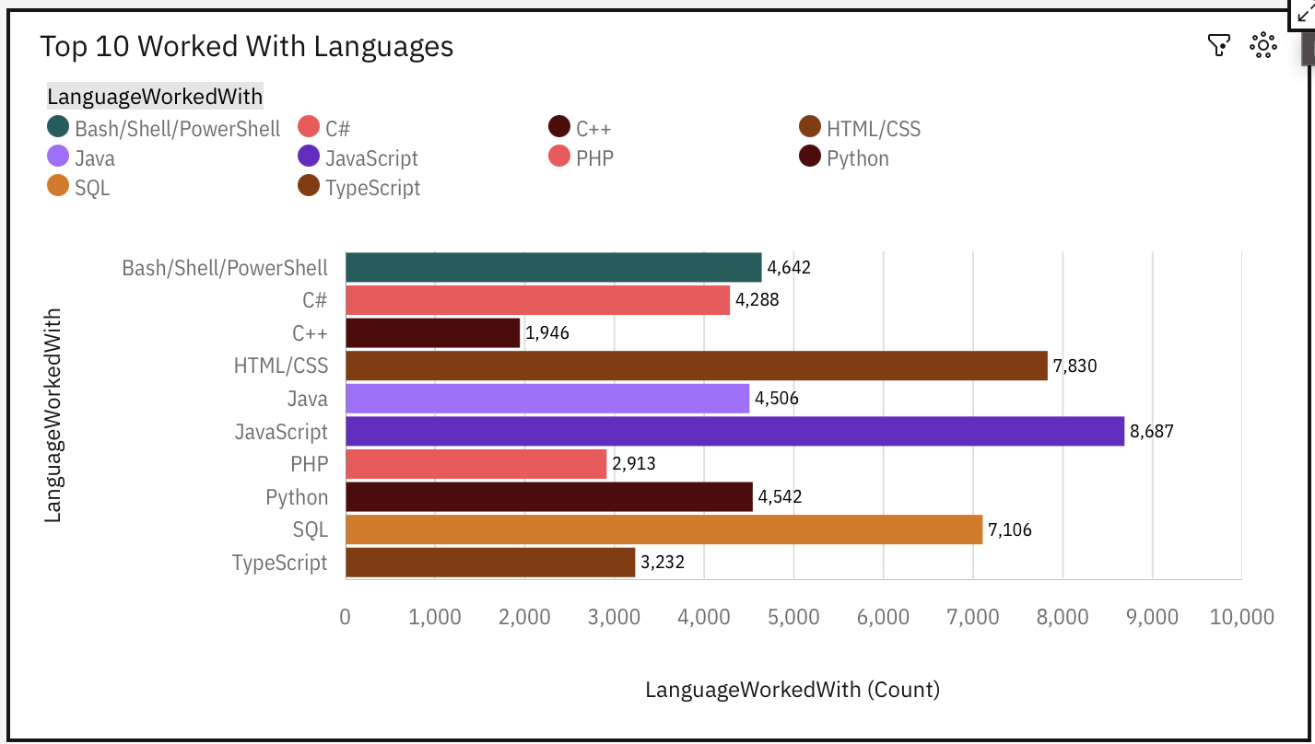
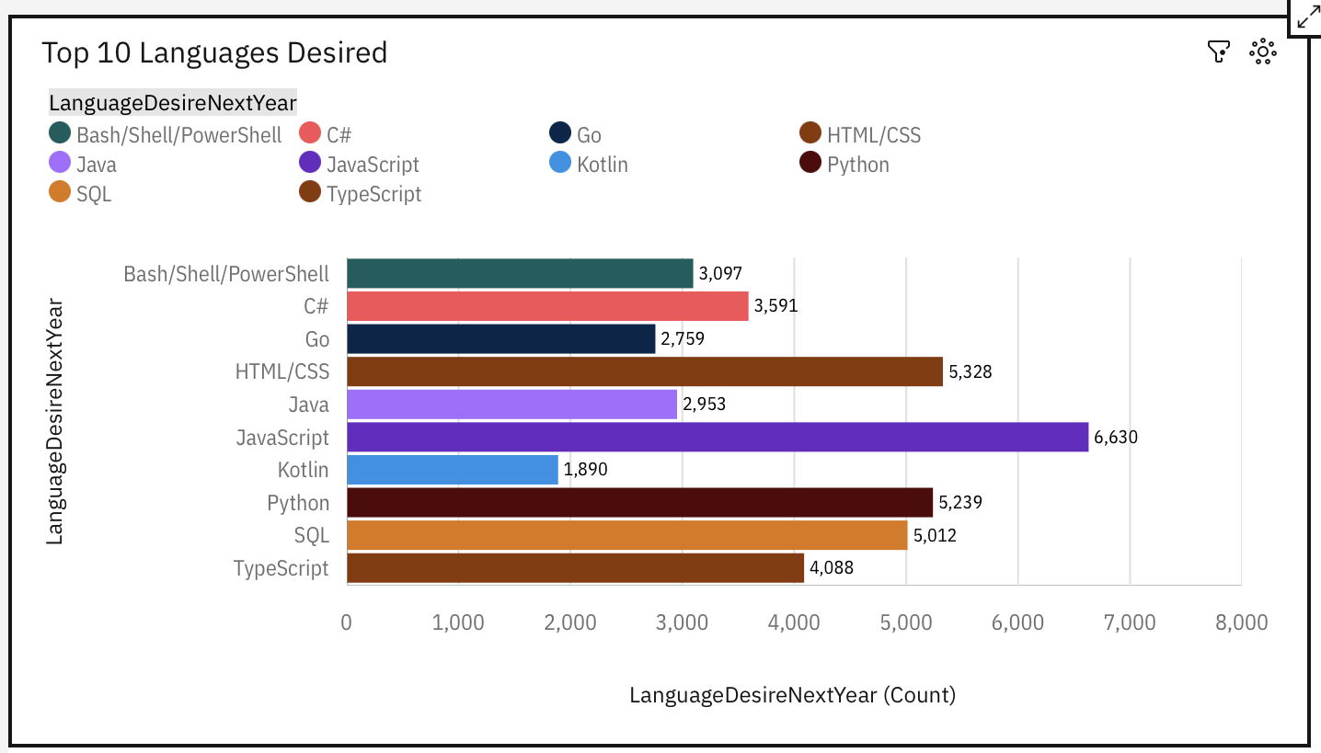
PROGRAMMING LANGUAGE TRENDS
Current Year
Next Year

Slide 8
PROGRAMMING LANGUAGE TRENDS - FINDINGS & IMPLICATIONS
Findings
JavaScript is currently the leading programming language
Python is going to be the fastest growing language
Implications
Javascript will still be leading in the future
Javascript will lose users to other programming languages
Python will take users from Javascript and SQL

Slide 9
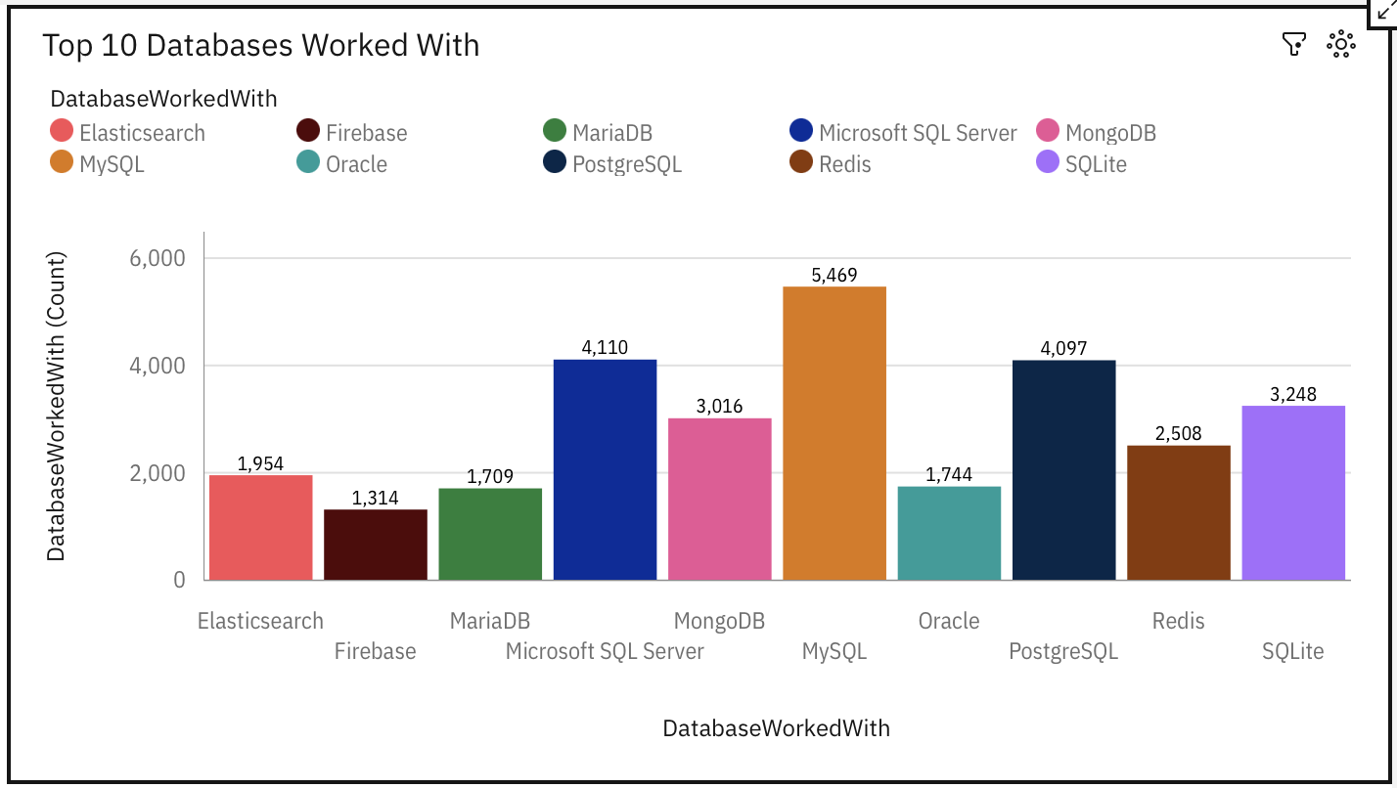
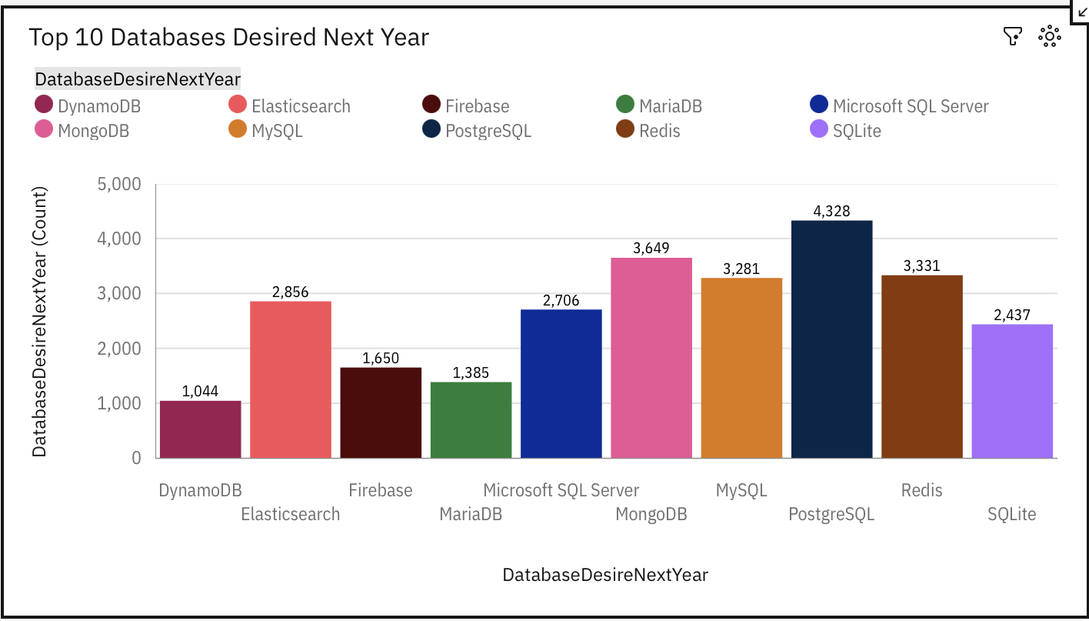
DATABASE TRENDS
Current Year
Next Year

Slide 10
DATABASE TRENDS - FINDINGS & IMPLICATIONS
Findings
MySQL is the leading program
ElasticSearch will be the fastest growing database
Oracle is going to phase out of top databases
Implications
MySQL and Microsoft SQL Server are losing traction.
PostgreSQL and MongoDB establishment in the market.

Slide 11

DASHBOARD
https://github.com/bpurifoy730/IBM-Cognos-Capstone/blob/main/Capstone.pdf

Slide 12
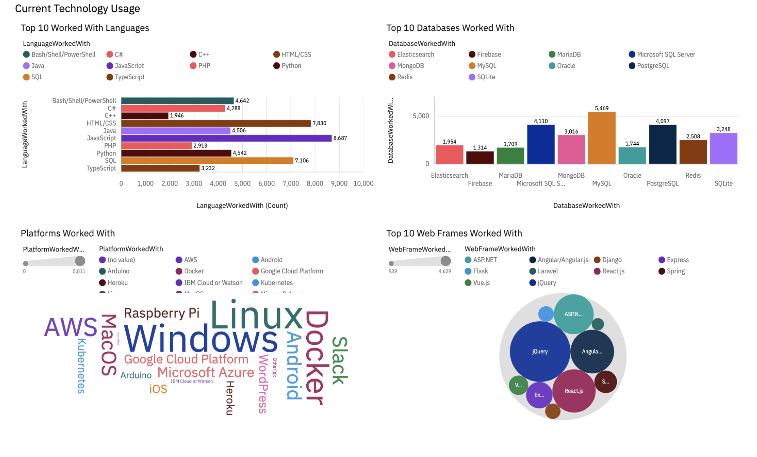
DASHBOARD TAB 1

Slide 13
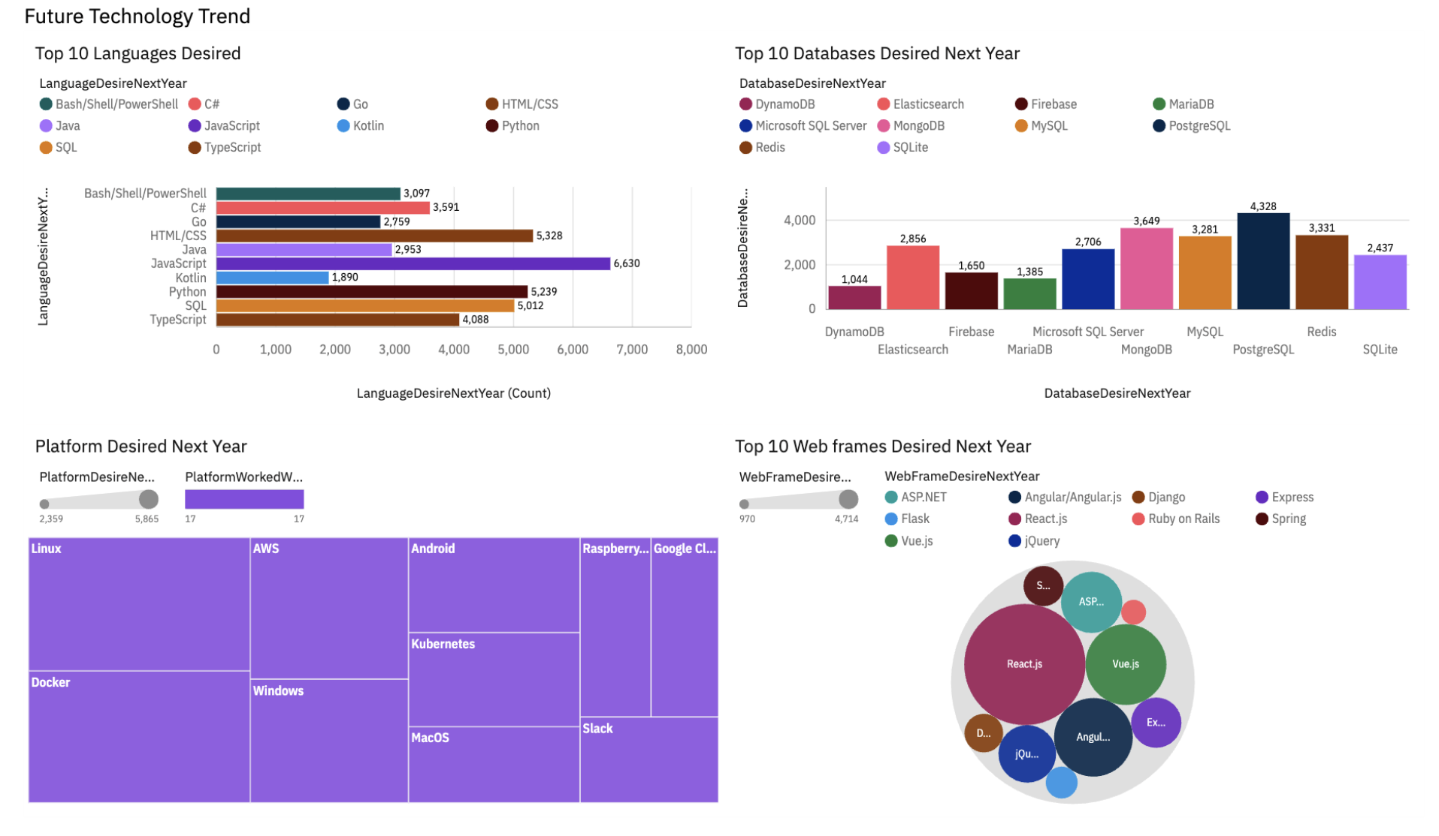
DASHBOARD TAB 2

Slide 14
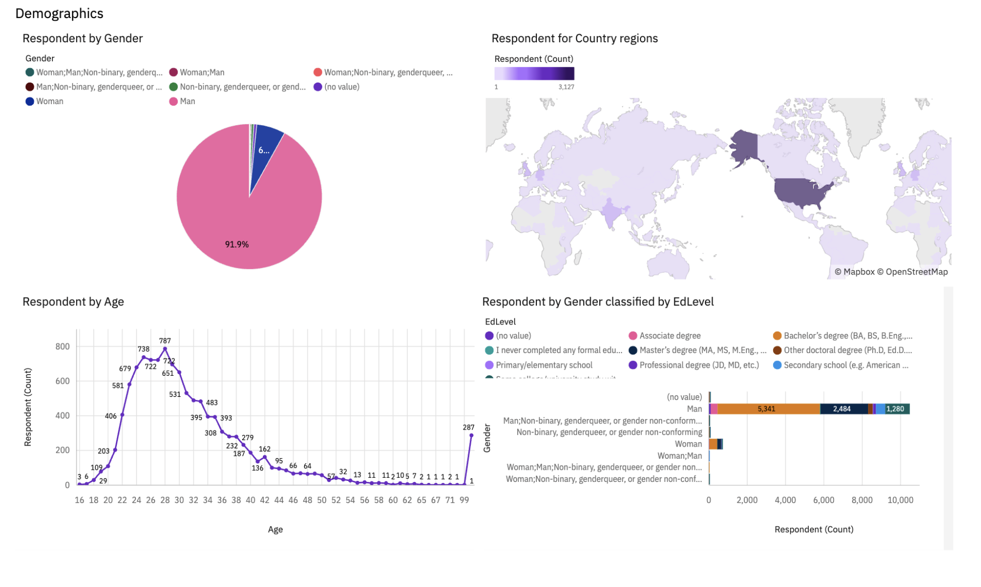
DASHBOARD TAB 3

Slide 15
DISCUSSION

Slide 16
OVERALL FINDINGS & IMPLICATIONS
Findings
JavaScript widely used and TypeScript getting popular.
Over 90% young male developers.
Developers are mainly in developed countries
Implications
Python will be one of the fastest growing programming languages
Higher education is not necessarily needed to be a developer

Slide 17

CONCLUSION
Developers are currently trying new languages, databases, phasing out older products
Developing has a dominant demographic drawn to the profession
Developers primarily use Windows and languages and databases that are compatible with the operating system

Slide 18

APPENDIX
Include any relevant additional charts, or tables that you may have created during the analysis phase.

Slide 19
JOB POSTINGS
In Module 1 you have collected the job posting data using Job API in a file named “job-postings.xlsx”. Present that data using a bar chart here. Order the bar chart in the descending order of the number of job postings.

Slide 20
POPULAR LANGUAGES
In Module 1 you have collected the job postings data using web scraping in a file named “popular-languages.csv”. Present that data using a bar chart here. Order the bar chart in the descending order of salary.

